Slide 1

NETWORKING BASICS 5

Slide 2
OSPF

Slide 3
Open Shortest Path First (OSPF)
Maintains 3 tables:
  Neighbor table
  Topology table
  Routing table
Triggered updates are sent
Also sends periodic updates on longer intervals
Uses the topology table and updates the routing table
Network is structured into routing areas to simplify administration, optimize traffic and resource utilization
Requires an hierarchical design (upon IP schema)

Slide 4
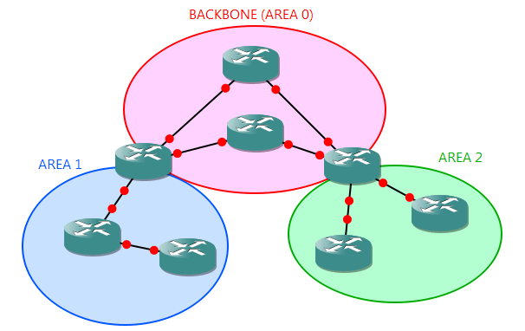
OSPF network

Slide 5
OSPF packet types
HELLO
Database description (DBD)
Link-State Request (LSR)
Link-State Advertisement (LSA)
Link-State Update (LSU)
Link-State Acknowledgement (LSACK)

Slide 6
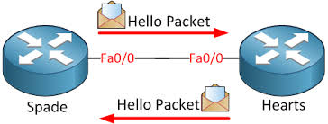
HELLO packet
Router ID
Hello/Dead interval*
Network mask*
Neighbors
Area ID*
Router priority
DR IP address
BDR IP address
Authentication password
Password
Stub Area Flag*
Hello timer
10 sec (Broadcast/P2P networks)
30 sec (NBMA networks)
Dead timer = 4 x hello timer

Slide 7
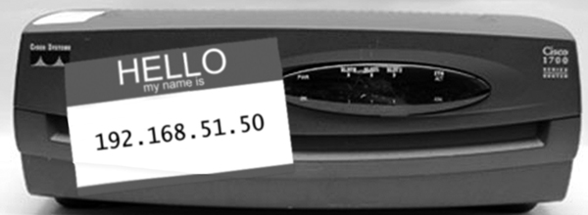
Router ID
Determines its router ID (32-bit address)
  Simply the router's name in the OSPF process
  Highest active interface IP address when OSPF process starts (Loopback interfaces beat physical interfaces)
OSPF router ID only changes when OSPF process is restarted (reset) or the router is rebooted
Best practice is to manually configure a router ID

Slide 8
Understanding OSPF neighbor relationships
DOWN: No hello received from the neighbor
INIT: The hello is seen from the neighbor
2-WAY: The router has seen its own router ID on the neighbor field in its received hello packet
EXSTART/EXCHANGE: Seen when neighbors trying to exchange DBD (Database description) packets
LOADING: Router sends/receive LSR (Link state request) packets and LSU (Link state update)
FULL: Good state ! Neighbors are synchronized !!

Slide 9
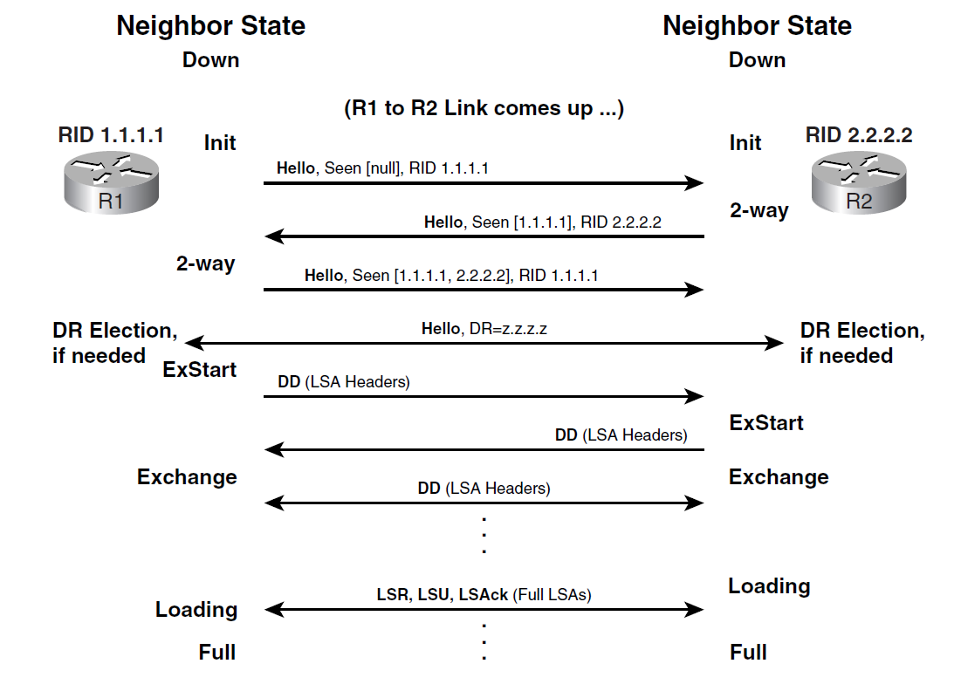
Full relationship process

Slide 10
OSPF Cost
Cost = 100 / Bandwidth in Mbps
Common costs
  56Kbps > 1785
  64Kbps > 1562
  T1 (1.544Mbps) > 65
  E1 (2.048 Mbps) > 48
  Ethernet (10Mbps) > 10
  Fast ethernet (100Mbps) > 1

Slide 11
Understanding the DR and BDR
Designated Router (DR) and Backup Designated Router (BDR)
On a shared network, one of them will be elected as DR and another as BDR
Router with highest priority (or) router ID will become the DR
Router priority is 1 by default
There is no DR/BDR on P2P network
Uses multicast 224.0.0.6 for updating DR/BDR
Uses multicast 224.0.0.5 for updating other neighbors
On a shared ethernet network, a maximum of only 2 FULL state relationship can be found

Slide 12
OSPF network types
Broadcast, multi-access networks
  Eg. Ethernet, Token ring
  Single operation mode
  DR/BDR election
Point-to-point networks
  Eg. T1, CAS, ISDN BRI/PRI
  Single operation mode
  No BDR/DR
Non-Broadcast Multi-Access (NMBA) networks
  Eg. Frame-relay, ATM
  Five modes of operation

Slide 13
NBMA modes
Non-Broadcast (NBMA) - RFC standard
Point-to-multipoint - RFC standard
Point-to-point - Cisco proprietary
Broadcast - Cisco proprietary
Point-to-multipoint, Non-broadcast - Cisco proprietary

Slide 14
Understanding LSA types
LSA type 1: Router LSA
LSA type 2: Network LSA (DR generated)
LSA type 3: Summary LSA (ABR summary route)
LSA type 4: Summary LSA (ASBR location)
LSA type 5: External LSA (ASBR summary route)

Slide 15
OSPF area types
Backbone Area (Area 0)
Stub area
Not-so-stubby area
Totally stubby area
Not-so-totally-stubby area

